Slide 1
Driving Impact in 100 Priority Basins through Collective Action and Digital Tools

Slide 2
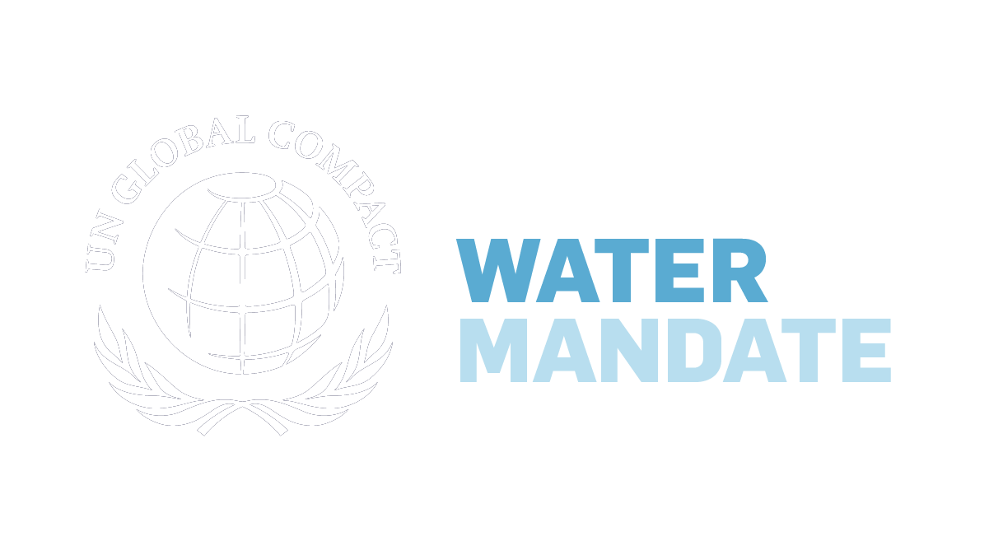
Digitization Vision & Strategy
Problem
Progress towards the 2030 goals of SDG 6 is not adequate
Many companies want to act but where and how is hard to determine
Finding actors in basins who can work together for Collective Actions is difficult

Slide 3
Digitization Vision & Strategy
Vision
01
Positive Impact in 100 Priority Basins
02
WASH Access for 300 million people

Slide 4
Digitization Vision & Strategy
Problem
Many tools exist for water issues but are siloed or not used
Impact measurement tools are lacking
Resource and knowledge sharing is difficult
Notes:
There are many data providers today providing a piece of the puzzle but no single source of comprehensive data across quantity, quality, and WASH.

Slide 5
Digitization Vision & Strategy

Slide 6
Digitization Vision & Strategy
Getting There
01
Leverage the power of digitization
02
Measure impact through digital monitoring
03
Open-source basin monitoring platform

Slide 7
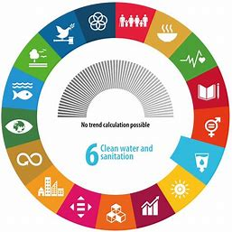
Digitization Vision & Strategy
Collective Actions
Scale the most impactful ones
Engagement & Investment
Bring more
Net Positive Water Impact
Align to WRC/Open Call goals

Slide 8
Innovation for Net Positive Water Impact: An Open-Source Basin Monitoring Platform

Slide 9
The Water Action Hub
Basin Diagnostics
Data sets
Data Collection
Net Positive
Water Impact
Impact Tracking

Slide 10
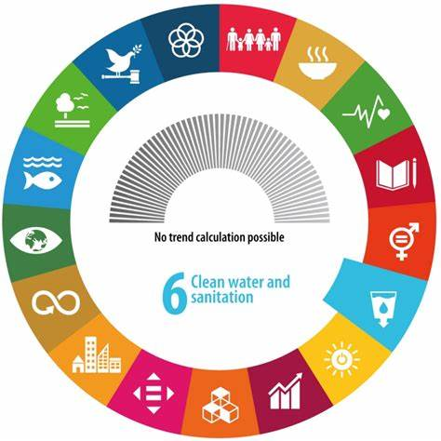
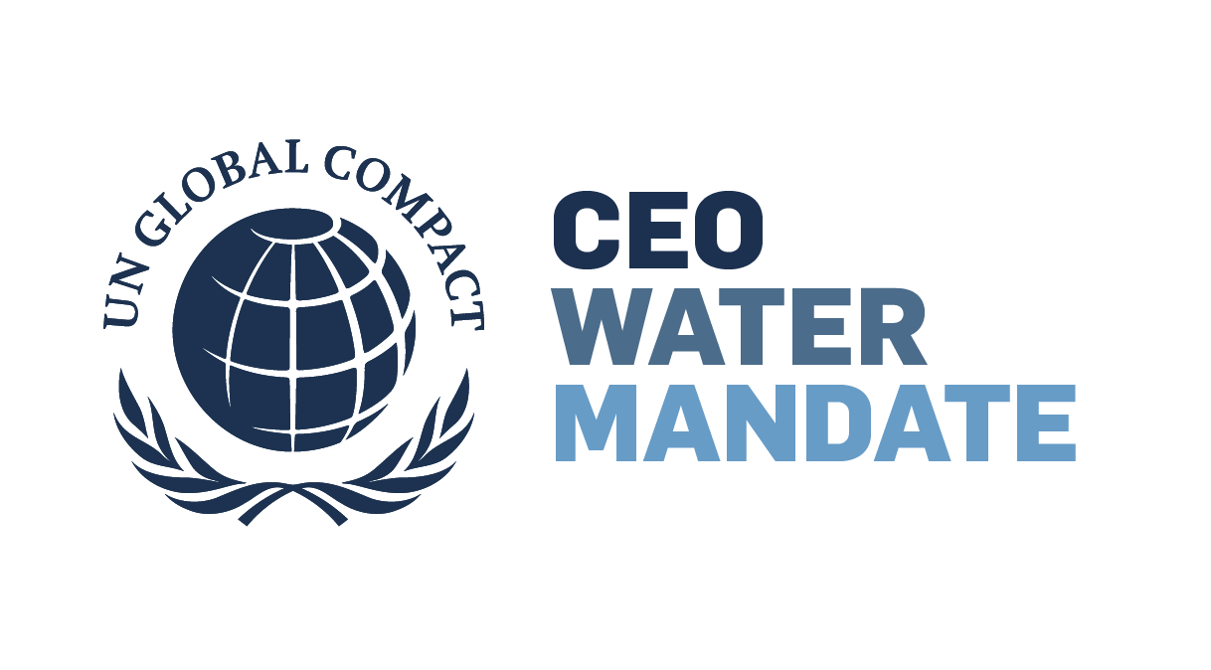
A vision for Open-Source River Basin Data​
Impact
Measurement
Basin Monitoring Platform
Satellite Imaging
Geospatial Data
WASH
In-Situ Data

Slide 11
Innovation for Net Positive Water Impact: An Open-Source Basin Monitoring Platform Discussion

Slide 12
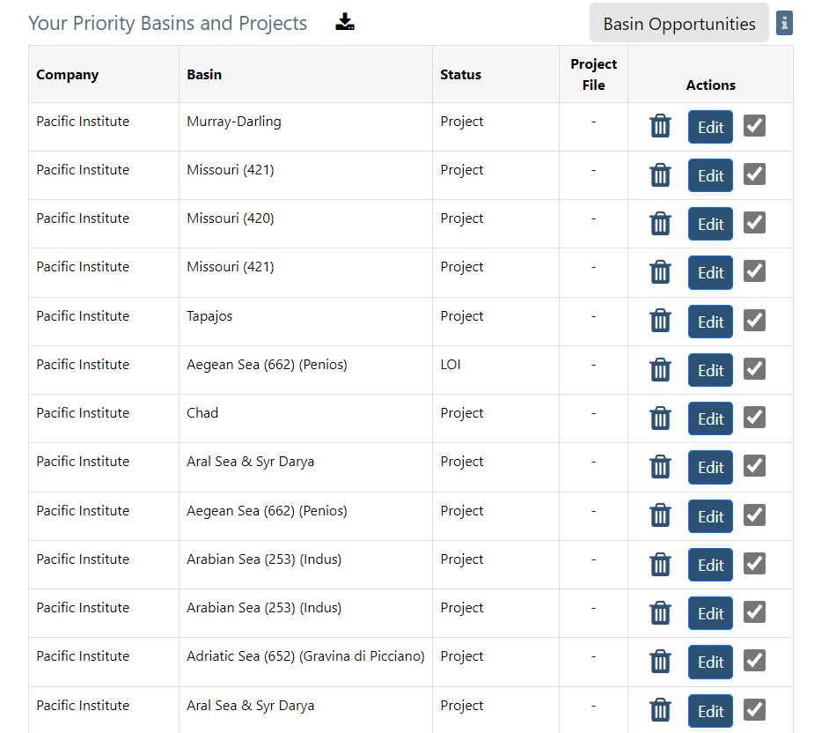
Original to be replaced by next slide

Slide 13
Pacific Institute Priority Basins
Current Basin Health
Pacific Institute Impacts
Quantity: 500,000 m³
Quality: 67%
WASH: 15,000 ppl

Slide 14
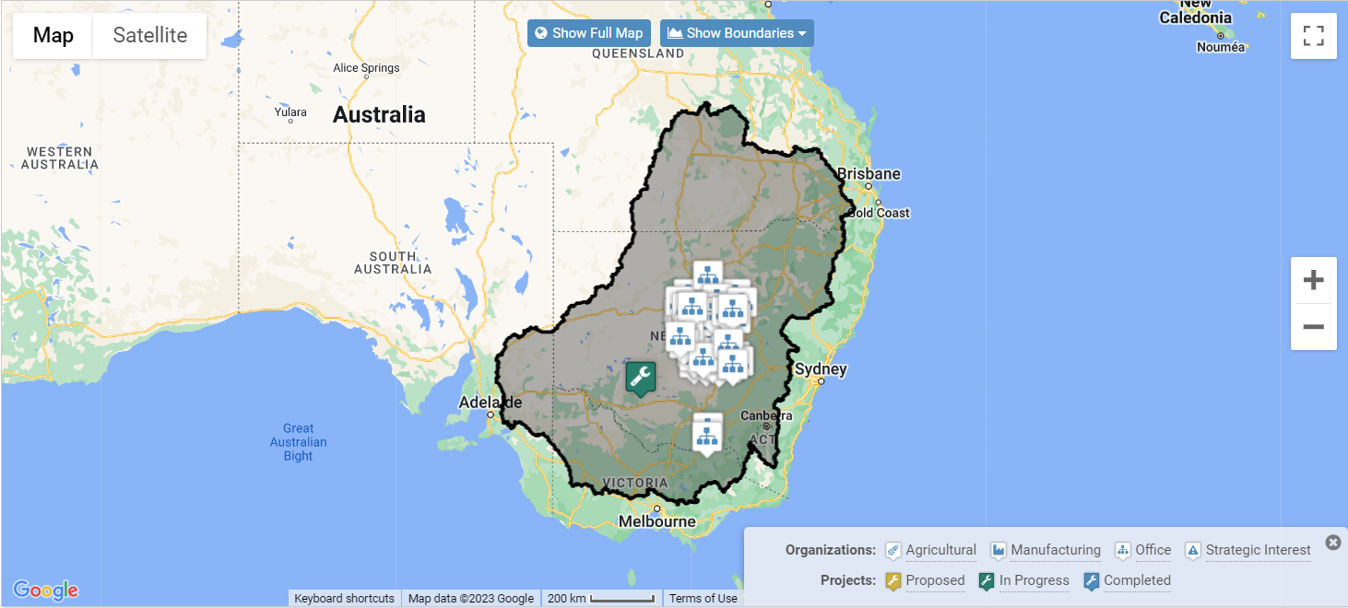
Murray-Darling Basin, Australia
Basin Aggregated Impacts
My Details
Current Status | Quantity | Quality | WASH
Overall
45
Million m³
Conserved/Returned
77%
Excess Pollutant
Removal
45
Thousand People
WASH Access
2,500
HA Conserved
And Restored
Basin Recruitment
Projects
Basin Collective Action Status
Project | Project Status | Funding
Water Fund | Planning | 1%
Women In WASH | Active | 80%
MD Replenishment Proj. | Active | 100%
PI Stewardship Proj. | Complete | -

Slide 15
Murray-Darling Basin, Australia
Basin Stress Status (Last 3 Years)
Point 1
Current Basin Stress Status
Location | Quantity | Quality | WASH
Point 1 (Source)
Point 2
Point 3
Point 4
Point 5
Point 6
Point 7 (Mouth)
My Project Status
Project | Project Status | Outcomes to Date
Wetland Restoration | Planning
Red Cliffs Access Project | Active | Access for 10,000 ppl
Aquifer Recharge Project | Active | 500,000 m³
Water Quality Mgmt | Complete | 99% Excess Nutrient Rem

Slide 16
Digitization Strategy Funding

Slide 17
Digitization Funding Needs
Period | Amount | Purpose
Year 1 | $2.25MM USD | Start-up, Scoping, Initial Technology Development, Pilot in 4 basins, ESA Projects
Year 2 | $2.8MM USD | Complete technology development, expand beyond 4 basins, operationalize global platform
Year 3 & Beyond | $1.25MM USD | Operations and Maintenance, Complete roll-out to 100 Priority Basins

Slide 18
Todd Player
Jason Morrison
André Ramalho
Digital Technology Program Manager
WRC/Mandate Head
WRC Coordinator
Pacific Institute / CEO Water Mandate
Pacific Institute / CEO Water Mandate
Pacific Institute / CEO Water Mandate
tplayer@pacinst.org
jmorrison@pacinst.org
avramalho@pacinst.org

Slide 19
Digitization Strategy Progress
Deliverable | Status
100 Priority Basins List & Mapping Tools
Collective Action Hub (Consultation Form)
Basin Diagnostics Template and Tools
Basin Stress Level Indicator
Corporate Water Benchmark Tool
NBS Benefits Explorer v2.0
ESA Innovation Projects
Digitization of WASH
Deliverable | Status
Basin Monitoring Platform
NPWI Reporting Template
Collective Action Reporting Template
My WAH Dashboard
Complete
In Progress
Not Started

